Slide 1






Rutgers University Libraries’ Union Workers
Presented by:
AFSCME COLT Local 1761

Slide 2




Overview
  Who We Are
  Benefits
  Challenges
COLLECTIVE
BARGAINING
Notes:
Introductions – Name and Titles

Slide 3



AFSCME COLT LOCAL 1761
Who are we?
  COLT (Clerical, Office, Laboratory & Technical Workers)
  President Maureen Camper & Secretary Treasurer Amy Joyner
Who do we represent?
  Our constitution was ratified 1984
  We have over 110 job titles on 3 campuses - we aren’t solely libraries
  We have over 400 full time staff members in the collective bargaining unit
Notes:
COLT has been representing library workers for Rutgers since 1984.
Rutgers has a large number of jobs and titles as an employer. Library workers are a part of what COLT is representing. We have list of over 110 titles.
Rutgers’ University Libraries union members: Rutgers’ libraries staff actually have 2 unions representing them - AFSCME & URA. Full time Library staff are usually in either AFSCME or URA. The exception to this are bosses with the title of “supervisor.” Some of our larger libraries rent space to different departments in the university and those staff members may or may not be affiliated with the union. Additionally, Rutgers has a federal work study program that employs students - these are our part time workers and are not affiliated with a union.

Slide 4






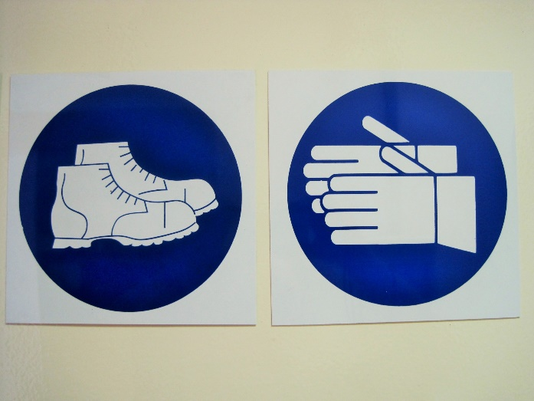
Benefits of membership
Time Off
Pension
Solidarity
Safe working conditions
Job Security
Health Benefits
Notes:
Time off- Vacation, AL, PH, Sick Time, Sick Leave, Breaks, Comp Time
Pension – Access to PERS & Deferred Compensation
Health Benefits – Some of the state’s best health care plans
Solidarity – Backup from AFSCME, access to lawyers, field reps to help with organizing
Safe working conditions
Job Security

Slide 5



CHALLENGES
  Upper
  Management
  Union
  Busting
  Recruitment
Notes:
Upper Management – higher levels of the university don’t understand or care about the dynamics of a union or what a contract is.
We see membership being asked to perform extra duties, or work out of title even if our contract says otherwise
Union Busting – Like much of the union world, COLT has to deal with union busting. Job titles can be moved to other departments, or other unions altogether that have different contract and leadership.
Recruitment- Like many unions, membership has become a challenge. After the Janus decision in 2018, recruiting has become more cumbersome. Recruitment is difficult, especially at a place like RUtgers. Rutgers is home to 11 libraries spread across 3 campuses. It can be difficult to organize and get the word out because everyone is spread out. You can have 10 COLT members in one location, or you can have 1. We need members to engage virtually and that can be difficult.

Slide 6

Thank's For Watching

